Slide 1
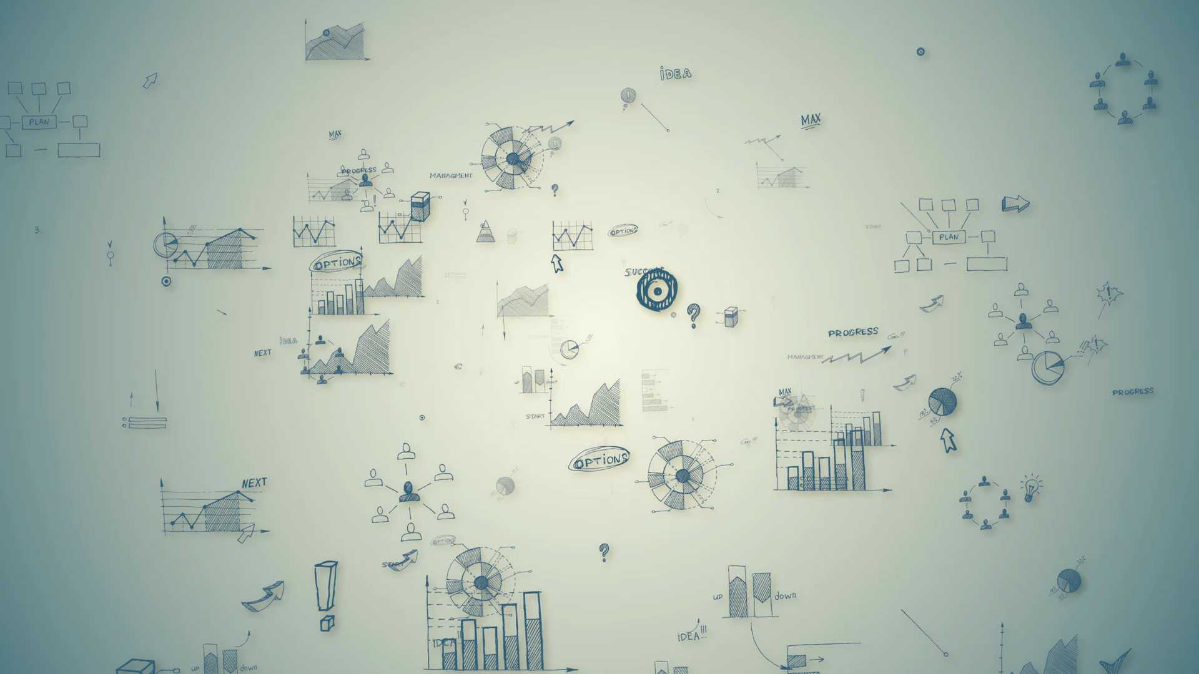

Statistical Modelling with Data
May 23 – June 02, 2023
Instructor: Qing (Leah) Li, Ph.D. Candidate at Cumming School of Medicine
qing.li2@uclagary.ca
Thank you Dr. Thuntida Ngamkham for contributing the contents
Thank you Dr. Qingrun Zhang and Dr. Quan Long for contributing some slides

Slide 2
Statistical Modelling with Data
Topic 1: Statistical Modelling
Lecture 1: First-order models with quantitative independent variables
Topic 2: Statistical Modelling with interactions (Assignment 1)
Lecture 2: Interaction effects, quantitative and qualitative variables
Lecture 3: Interaction effects and second-order models
Topic 3: Statistical Model selection (Assignment 2)
Lecture 4: Model selection: Stepwise regression, Forward selection and Backward Elimination
Lecture 5: Model selection: Evaluate the reliability of the model chosen
Topic 4: Statistical model diagnostics
Lecture 6: Multiple regression diagnostics: verify linearity, independence, equal variance assumptions and normality assumptions.
Lecture 7: Multiple regression diagnostics: identify multicollinearity and outliers and data transformation.
Topic 5: Transfer learning
Lecture 8: Deep learning basics
Lecture 9: Transfer-learning (Bonus): standing on the shoulders of giants.

Slide 3
Statistical Modelling with Data
Topic 1: Statistical Modelling
Lecture 1: First-order models with quantitative independent variables
Topic 2: Statistical Modelling with interactions (Assignment 1)
Lecture 2: Interaction effects, quantitative and qualitative variables
Lecture 3: Interaction effects and second-order models
Topic 3: Statistical Model selection (Assignment 2)
Lecture 4: Model selection: Stepwise regression, Forward selection and Backward Elimination
Lecture 5: Model selection: Evaluate the reliability of the model chosen
Topic 4: Statistical model diagnostics
Lecture 6: Multiple regression diagnostics: verify linearity, independence, equal variance assumptions, and normality assumptions.
Lecture 7: Multiple regression diagnostics: identify multicollinearity and outliers and data transformation.
Topic 5: Transfer learning
Lecture 8: Deep learning basics
Lecture 9: Deep learning advances: Transfer-learning (Bonus).

Slide 4
Statistical Modelling with Data
Learning Outcomes: At the end of the course, participants will be able to
Model the multiple linear relationships between a response variable (Y) and all explanatory variables (both categorical and numerical variables) with interaction terms. Interpret model parameter estimates, construct confidence intervals for regression coefficients, evaluate model fits, and visualize correlations between a response variable (Y) and all explanatory variables (X) by graphs (scatter plot, residual plot) to assess model validity.
Predict the response variable at a certain level of the explanatory variables once the fit model exists.
Implement R-software and analyze statistical results for biomedical and other data.
Evaluations
Assignments will be posted on Slack (our communication tool with students).
Students must attend 70% (6/9) of the sessions in order to receive the certificate and are encouraged to work on the assignments progressively throughout the course as the relevant material is covered.

Slide 5
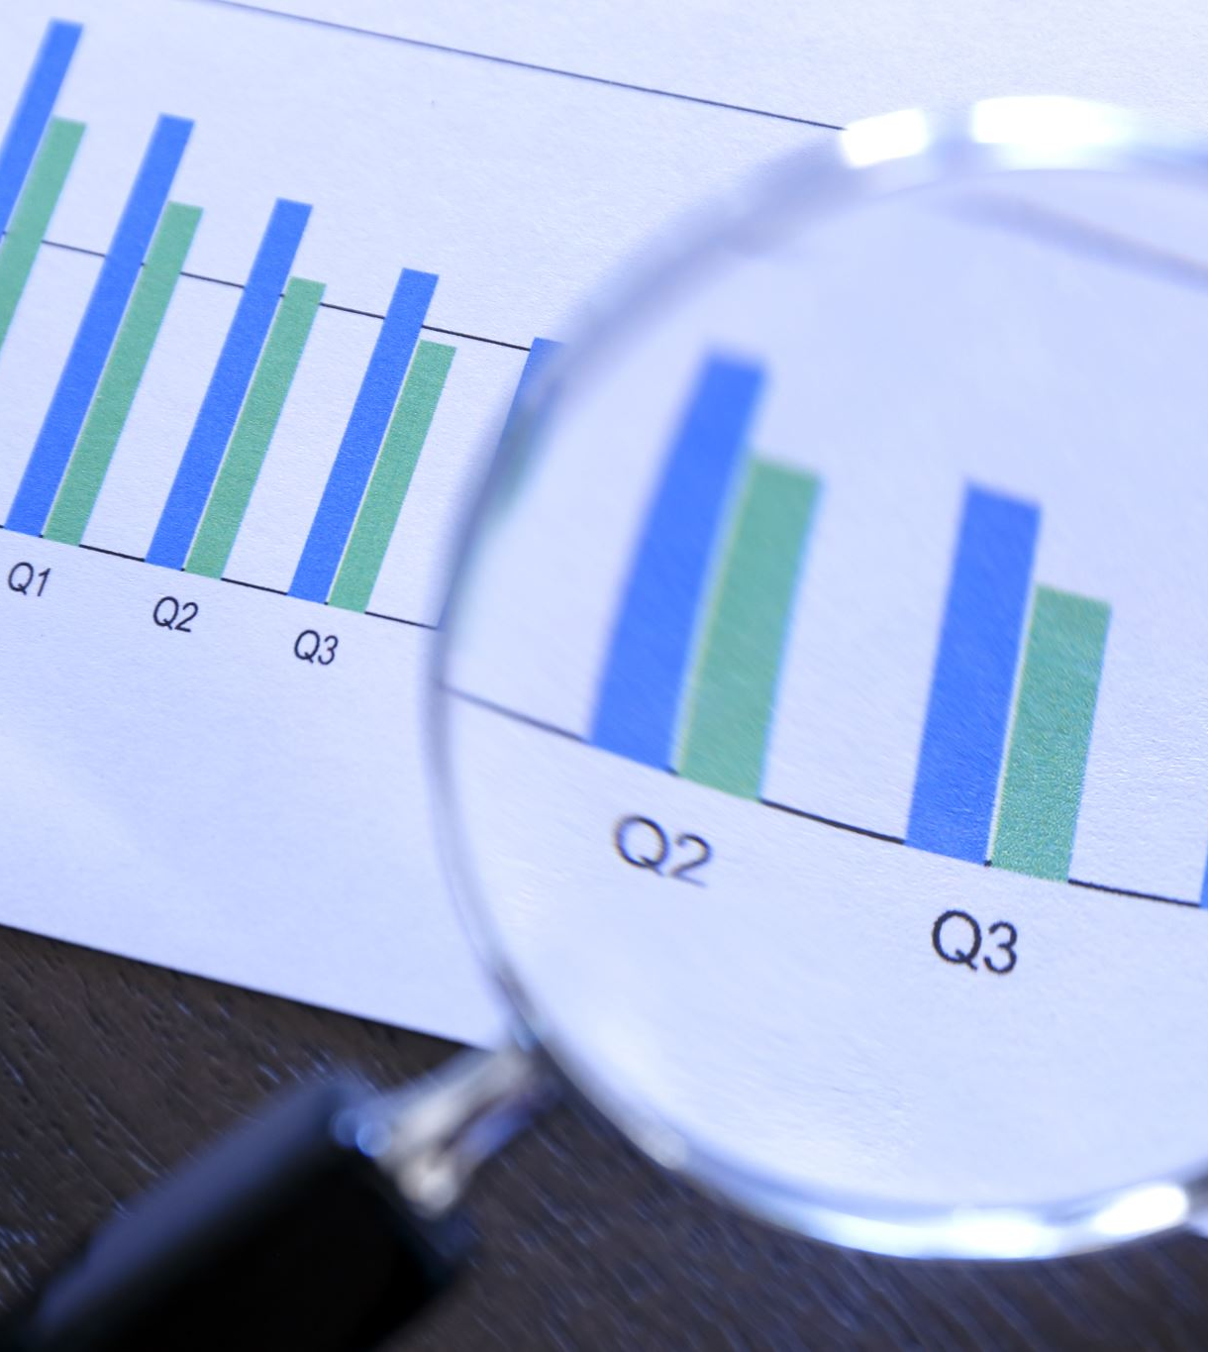
Statistical Modelling with Data
Supportive materials
Lectures slides (2023)
R code scripts (2023)
PDF (dated 2022)
Two Assignments (dated 2022)
Slack channels
Recoding videos
Exercises
Course-documents

Slide 6
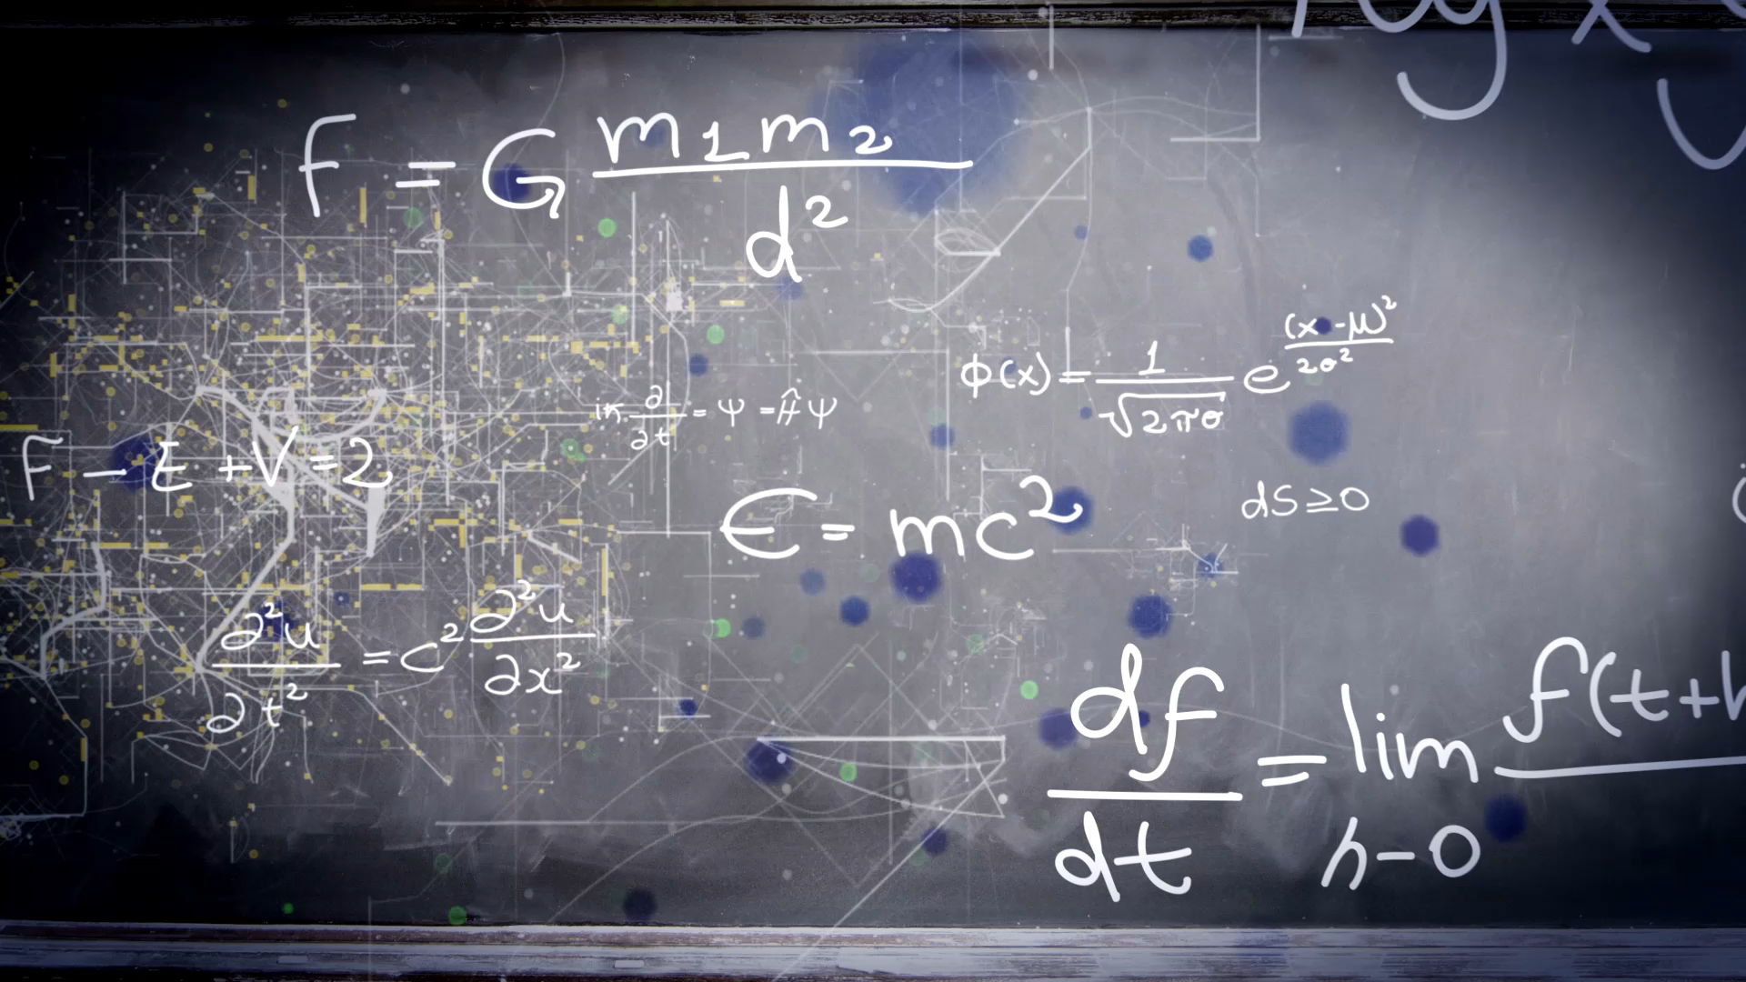
Lecture 8: Deep learning advances
Notes:
Hello everyone! I hope you're all doing well. Today marks the last lecture for section II statistical modelling with data. How has the journey been for you so far? Personally, I must admit that I'm feeling a bit tired. I may have been a bit too enthusiastic in preparing and teaching these past nine days. It's quite an intense experience to cover so much material in such a short time. I apologize for it if you guys feel it the same way. Maybe I should reduce some materials and make the course less intensive next year.
This weekend, I can finally take a break and relax. I plan to do absolutely nothing and give my mind a total release. As we head into the weekend, I encourage you all to take some well-deserved rest and relaxation. You've achieved so much in such a short time, and it's truly remarkable. This weekend, go ahead, spoil yourself with a nice gift. You’ve earned it.

Slide 7
Quick recap of deep learning basics
What is deep learning and why?
Build a deep learning model:
Neural network
Activation function
Loss function
TensorFlow
Datasets
Split data into training and test dataset
Model training and evaluation
Training
Evaluation Metrics
Notes:
Since yesterday, we've been delving into the fascinating world of neural networks. I’ve showed you what a NN looks like. DNN usually have enormous layers. As a results, enormous parameters to estimate and requires a lot of data. Our main goal is to precisely estimate these parameters. We do this by giving the networks a lot of information, which helps them find trends and store them as weights and biases at the edges of the neurons. We also explore the utilization of activation functions and the significance of the loss function. After the break, we delved into the concept of data used to train NNs. The whole data is split in two groups, training and test. We use the training set to train the model, and then evaluate its performance on the test set. During the training process, the model adjusts its parameters, such as weights and biases, in order to minimize the loss. The objective is to fine-tune these parameters so that the model achieves a low loss value, indicating better performance and accuracy.

Slide 8
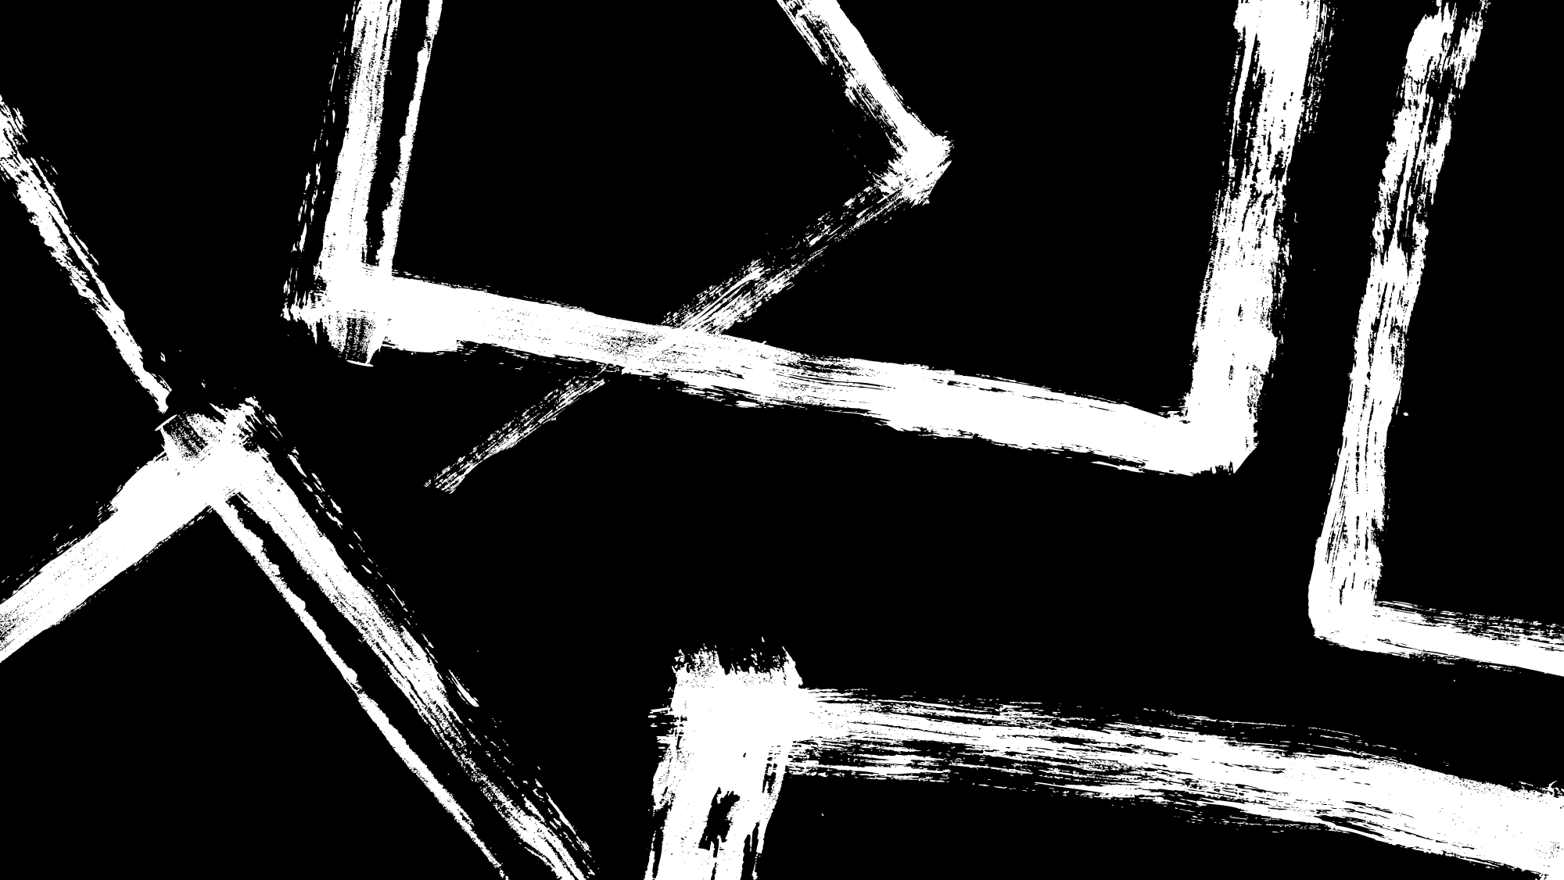
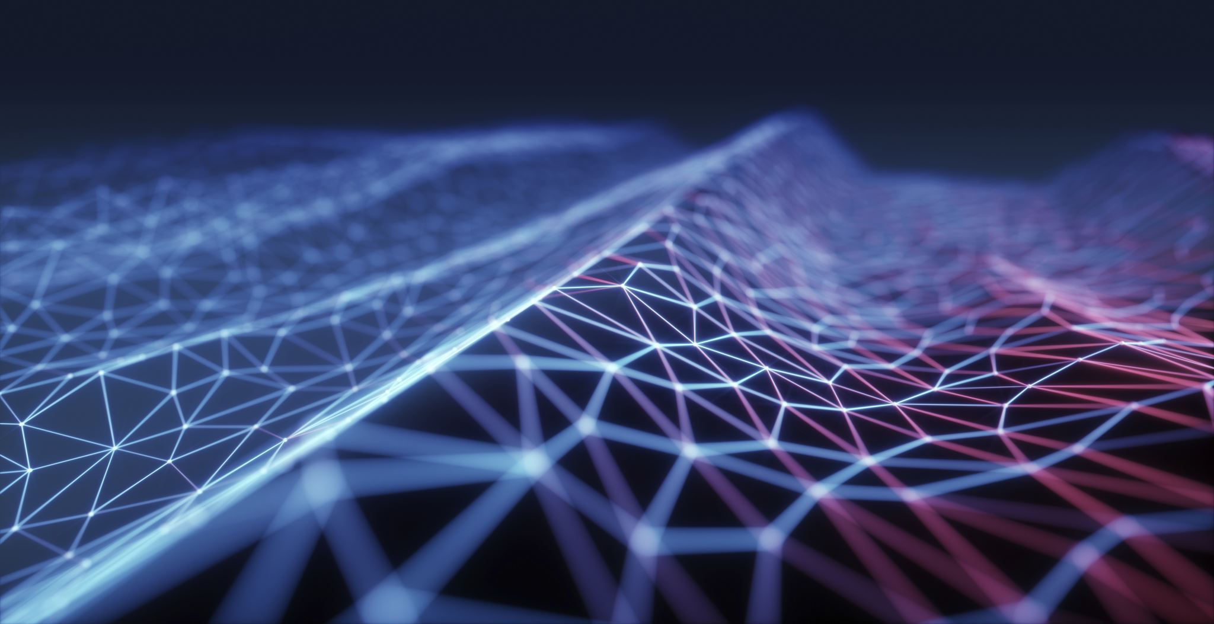
Outlines
Convolution Neural Network (CNN)
Transfer learning
Notes:
Today, let's delve a bit deeper into the world of deep learning. Apart from the basic fully connected neural network, we will explore an additional types of layers named convolutional layer today, specifically focusing on image classification tasks.
After the break, I will introduce you to a highly valuable technique in the field of deep learning known as transfer learning. It is a powerful approach that allows us to leverage pre-trained models and apply their knowledge to new tasks, saving us time and computational resources.

Slide 9
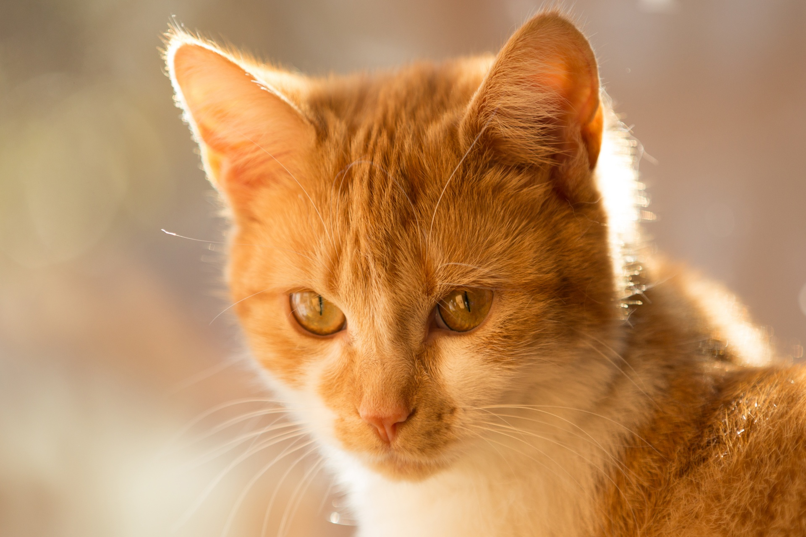
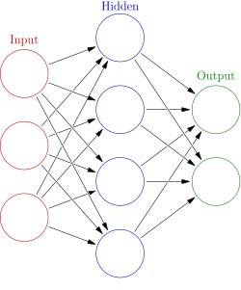
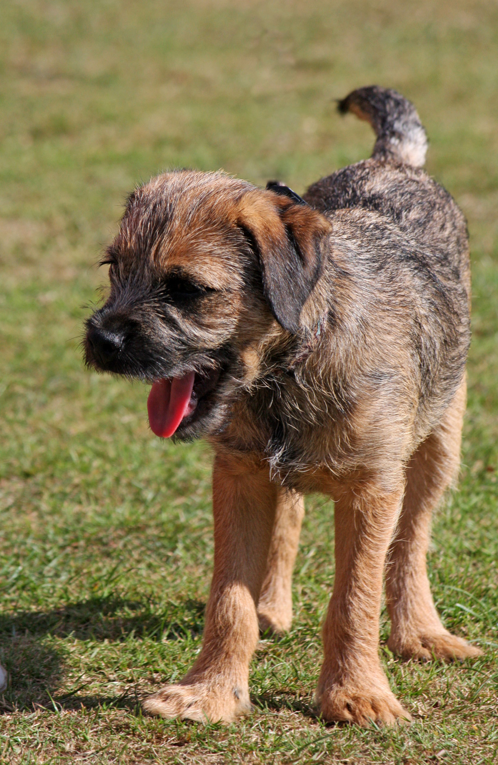
How can we feed images to NN?
Fully connected layer
h1
X1
h2
$$Y_{1}= ω_{0}+ω_{1}X_{1}+ω_{2}X_{2}+ω_{3}X_{3}+ ε$$
Y1
$$Y_{2}= β_{0}+β_{1}X_{1}+β_{2}X_{2}+β_{3}X_{3}+ ε$$
X2
h3
Y2
X3
h4
Fully connected network
Notes:
Here is how a simple NN looks like. How can we feed images into these NN?
As you can see in the diagram, we have a set of inputs. One approach is to feed in the pixel values of an image and flatten it. By doing so, we transform the image from a two-dimensional structure to a one-dimensional array, where each element represents a pixel. However, this transformation disregards the spatial relationships between pixels, such as the edges that define the shape of a cat's ear.
So we need to think about another way to feed images into NN.

Slide 10
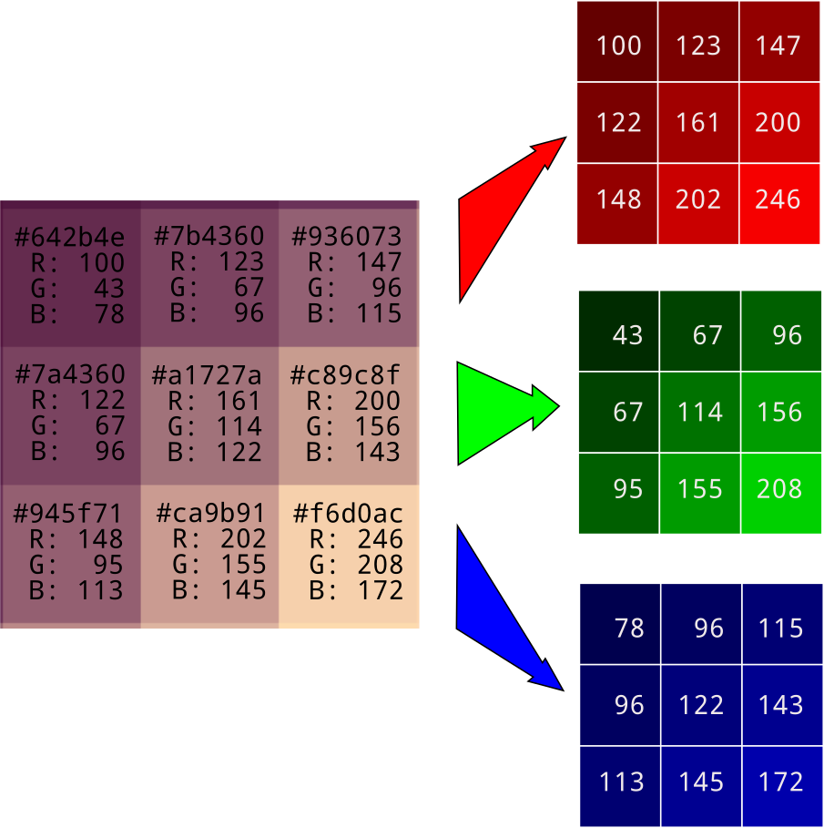
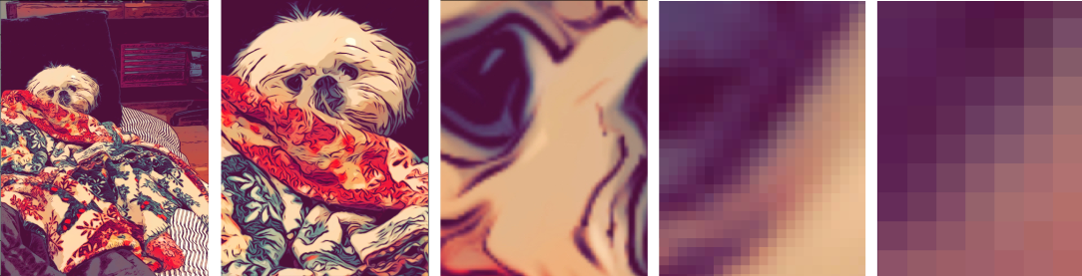
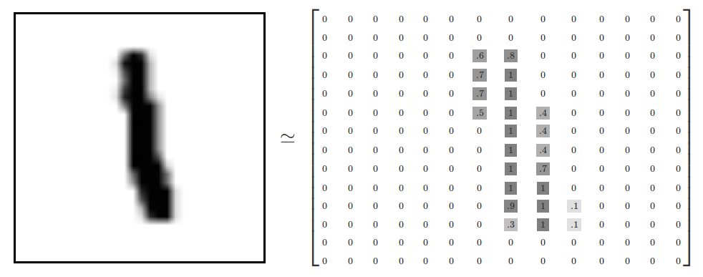
View pictures in “eyes” of computer
Channel
https://www.kdnuggets.com/2020/01/convert-picture-numbers.html
Notes:
Let's take a closer look at how computers perceive and process pixels in images. When a computer analyzes an image, it views it in terms of channels. The most common channels are red, green, and blue, often referred to as RGB. Each pixel in the image has values for red, green, and blue channels, representing the intensity of those colors at that particular pixel. By combining these average values, the computer generates the final output for that pixel. This process is repeated for each pixel in the image, ultimately creating the full image representation.
To simplify the explanation, let's consider a grayscale image, where each pixel has a single value representing its intensity level.

Slide 11
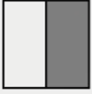

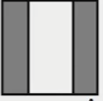

An example: Vertical edge detection
10 | 10 | 10 | 0 | 0 | 0
10 | 10 | 10 | 0 | 0 | 0
10 | 10 | 10 | 0 | 0 | 0
10 | 10 | 10 | 0 | 0 | 0
10 | 10 | 10 | 0 | 0 | 0
10 | 10 | 10 | 0 | 0 | 0
Kernel
0 | 30 | 30 | 0
0 | 30 | 30 | 0
0 | 30 | 30 | 0
0 | 30 | 30 | 0
1 | 0 | -1
1 | 0 | -1
1 | 0 | -1
$$∗$$
Source Andrew Ng
Notes:
For simplicity, let's consider a square matrix where the number of rows and columns are the same.
Now let’s involve another squared matrix, which we usually call Kernel. A kernel is also a square matrix, typically smaller in size than the image matrix. The values within the kernel determine the nature of the operation being performed. In this example, we focus on detecting edges in the images. So a commonly used kernel looks like this.
Now, let’s do some Calculations. Let’s apply the kernel to the image matrix in a sliding window fashion. This involves element-wise multiplication between the kernel and the corresponding region of the image matrix. The resulting products are then summed up to produce a single value.
Place the kernel over the top-left corner of the image matrix.
Perform element-wise multiplication between the values in the kernel and the corresponding values in the image matrix region covered by the kernel.
Sum up the products obtained from the element-wise multiplication.
Store the sum as the result at the corresponding position in the output matrix.
Move the kernel one step to the right (or down, depending on the sliding direction) and repeat steps 2-4 until the entire image matrix has been processed.
By sliding the kernel over the image matrix and performing the element-wise multiplication and summation for each region, we can obtain an output matrix that represents the processed image. The values in the kernel determine the weights or filters applied to the corresponding image regions, influencing the specific operation being performed, such as blurring, sharpening, or feature extraction.
This whole process is named convolution.

Slide 12

An example: Vertical edge detection
Kernel
0 | 30 | 30 | 0
0 | 30 | 30 | 0
0 | 30 | 30 | 0
0 | 30 | 30 | 0
-30 | 30
-30 | 30
-30 | 30
-30 | 30
1 | 0 | -1
1 | 0 | -1
1 | 0 | -1
$$∗$$
Source Andrew Ng
Notes:
Ok, let’s conduct the convolution again for the output of the previous slide. Here the final results we will get.
If we visualize this output matrix as a grayscale image, where darker shades represent lower values and lighter shades represent higher values, we are pretty sure that edges present here.

Slide 13

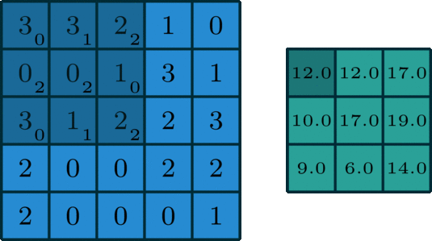
Dynamic Visualization of convolution
5 x 5
3 x 3
5 x 5 3 x 3
https://towardsdatascience.com/intuitively-understanding-convolutions-for-deep-learning-1f6f42faee1
13
Notes:
So far, we have learned about the convolutional process.
Here is a better illustration of such process.
We have an input image matrix and a kernel matrix. The kernel moves across the image, performing an element-wise multiplication at each part it covers. This helps us identify patterns and features in the image. Through the convolution operation, we obtain a new matrix that represents the output. Additionally, the convolution process can also reduce the size of the image.

Slide 14
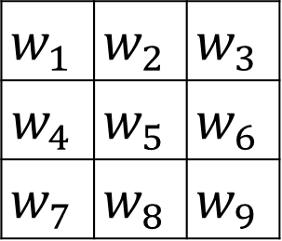

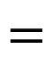
Padding
(n+2p) x(n+2p)
(n+2p-f+1) x(n+2p-f+1)
f x f
$$w_{1}$$ | $$w_{2}$$ | $$w_{3}$$
$$w_{4}$$ | $$w_{5}$$ | $$w_{6}$$
$$w_{7}$$ | $$w_{8}$$ | $$w_{9}$$
$$∗$$
$$=$$
P =padding =1, matrix 6 x 6 => 8 x 8
Notes:
Padding: If you see the animation above, during the convolution process, the edges essentially get “trimmed off”, converting a 5×5 feature matrix to a 3×3 one. The pixels on the edge are never at the center of the kernel, because there is nothing for the kernel to extend to beyond the edge. This isn’t ideal, as often we’d like the size of the output to equal the input.
Padding does something pretty clever to solve this: pad the edges with extra, “fake” pixels (usually of value 0, hence the oft-used term “zero padding”). This way, the kernel when sliding can allow the original edge pixels to be at its center, while extending into the fake pixels beyond the edge, producing an output the same size as the input.

Slide 15
Max polling
MAX
Max Pooling is a pooling operation that calculates the maximum value for patches of a feature map and uses it to create a down sampled (pooled) feature map. It is usually used after a convolutional layer. It adds a small amount of translation invariance - meaning translating the image by a small amount does not significantly affect the values of most pooled outputs.
MAX

Slide 16
Kernels and filters
1 | 0
1 | 1
Y1 | Y2
Y3 | Y4
1 | 0
1 | 1
Y1 | Y2
Y3 | Y4
1 | 0
1 | 1
Y1 | Y2
Y3 | Y4
A filter: A collection of kernels
Notes:
Let's shift our focus to colorful images, which are a bit more complex than grayscale images. In colorful images, we have three channels: red, green, and blue. Each channel represents different color information. Similarly, we can break down the image matrix into three matrices: the red matrix, the green matrix, and the blue matrix.
For each of these three matrices, we will apply a corresponding kernel matrix. As a result, we will obtain three separate outputs.
Each filter in fact consists of a collection of kernels, where each kernel corresponds to a single input channel to the layer. Each kernel is unique in its characteristics and purpose.

Slide 17
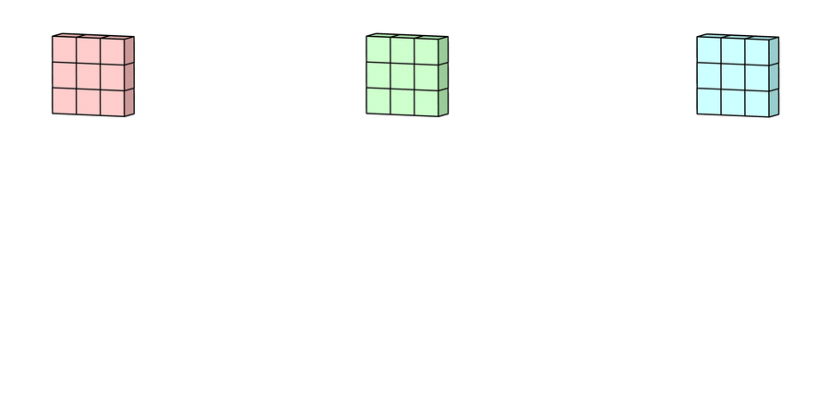
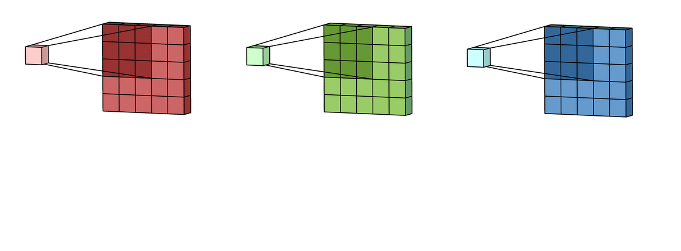
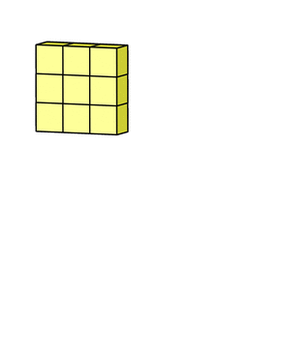
Kernels and filters
The changed versions from each channel are then added together to make one channel. Each kernel in a filter makes one form of each channel, and the filter as a whole makes one channel.
Each kernel of the filter "slides" over its own input channel to make a changed version of that channel.
The last term is the bias term. Each output filter has its own bias term, which is how the bias term works in this case. So far, the output channel is made up of the output channel and the bias.
https://towardsdatascience.com/intuitively-understanding-convolutions-for-deep-learning-1f6f42faee1
Notes:
Here are dynamic views of what happed to RGB channel and I hope they can help you understand how convolution process works on colourful images better.

Slide 18
Convolution
Convolution process is to slide the kernel over the image matrix and perform the element-wise multiplication and summation for each region. It outputs matrix that represents the processed image. [Definition in deep learning]
In mathematics (in particular, functional analysis), convolution is a mathematical operation on two functions (f and g) that produces a third function (f*g) that expresses how the shape of one is modified by the other (Wiki). [Broader definition]
Channels: one color is one channel. Three channels (red, green, blue) for colorful pictures and one channel for black and white pictures
Kernels: square matrix contains numeric values. They combine pixels only from a small, local area to form an output.
Filters: a collection of kernels
Padding: pad the edges with extra, “fake” pixels (usually 1 column on left, 1 on right, 1 row on top and 1 row on bottom. Pixels with 0 values).
Max polling: the largest value of each patch in a feature map is used in a pooling process to make a down sampled (pooled) feature map.
https://www.databricks.com/glossary/convolutional-layer
Notes:
Let's summarize what we have covered so far. We discussed the convolutional process, which involves sliding a kernel over an image matrix and performing element-wise multiplication. This process generates an output matrix that represents the processed image. This is a common definition of convolution in deep learning. However, in the real world, the definition may vary.

Slide 19
Convolution layer VS fully connected layer
How many parameters (w, b) we need? 9*4*2=72
How many parameters (w, b) we need? 9*4*2=72
How many parameters (w, b) we need? 9*4*2=72

Slide 20
Convolution layer VS fully connected layer
Inputs Kernels Raw Outputs Final outputs
X1 | X2 | X3
X4 | X5 | X6
X7 | X8 | X9
W1 | W2
W3 | W4
Y1 | Y2
Y3 | Y4
X1 | X2 | X3
X4 | X5 | X6
X7 | X8 | X9
W1 | W2
W3 | W4
Y1 | Y2
Y3 | Y4
Y1 | Y2
Y3 | Y4
Y1 | Y2
Y3 | Y4
+ b1
X1 | X2 | X3
X4 | X5 | X6
X7 | X8 | X9
W1 | W2
W3 | W4
Y1 | Y2
Y3 | Y4
Notes:
The convolution then, as a whole, is still a linear transformation, but at the same time it’s also a dramatically different kind of transformation.

Slide 21
Multiple filters
Inputs Filter1: Kernels Raw Outputs 1 Final outputs 1
X1 | X2 | X3
X4 | X5 | X6
X7 | X8 | X9
W1 | W2
W3 | W4
Y1 | Y2
Y3 | Y4
Y1 | Y2
Y3 | Y4
Y1 | Y2
Y3 | Y4
W1 | W2
W3 | W4
+ b1
X1 | X2 | X3
X4 | X5 | X6
X7 | X8 | X9
Y1 | Y2
Y3 | Y4
X1 | X2 | X3
X4 | X5 | X6
X7 | X8 | X9
W1 | W2
W3 | W4
Y1 | Y2
Y3 | Y4
Filter2: Kernels Raw Outputs 2 Final outputs 2
W1 | W2
W3 | W4
Y1 | Y2
Y3 | Y4
Y1 | Y2
Y3 | Y4
Y1 | Y2
Y3 | Y4
W1 | W2
W3 | W4
Y1 | Y2
Y3 | Y4
+ b
W1 | W2
W3 | W4
Y1 | Y2
Y3 | Y4
Keep doing that???
Notes:
The convolution then, as a whole, is still a linear transformation, but at the same time it’s also a dramatically different kind of transformation.

Slide 22
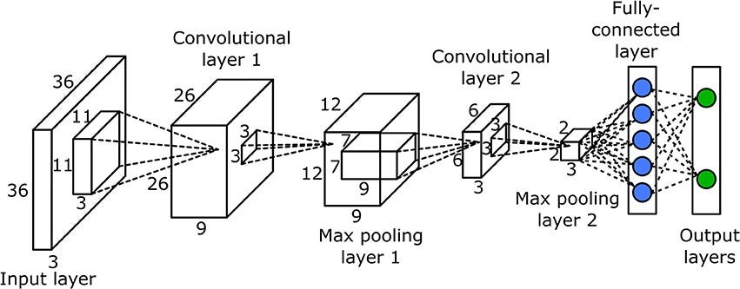
Convolutional Neural Network (CNN)
Probability of being class1
Probability of being class2
https://medium.com/swlh/building-a-simple-convolution-layer-from-scratch-317f82dc3805
Notes:
CNNs enforce a local connectivity pattern between neurons of adjacent layers.

Slide 23
Convolutional Neural Network (CNN)
0
1
Label : [0, 1]
Class1: dog, Class2: cat
https://medium.com/swlh/building-a-simple-convolution-layer-from-scratch-317f82dc3805
Notes:
CNNs enforce a local connectivity pattern between neurons of adjacent layers.

Slide 24
Convolutional Neural Network (CNN)
1
0
Label : [1, 0]
https://medium.com/swlh/building-a-simple-convolution-layer-from-scratch-317f82dc3805
Notes:
CNNs enforce a local connectivity pattern between neurons of adjacent layers.

Slide 25
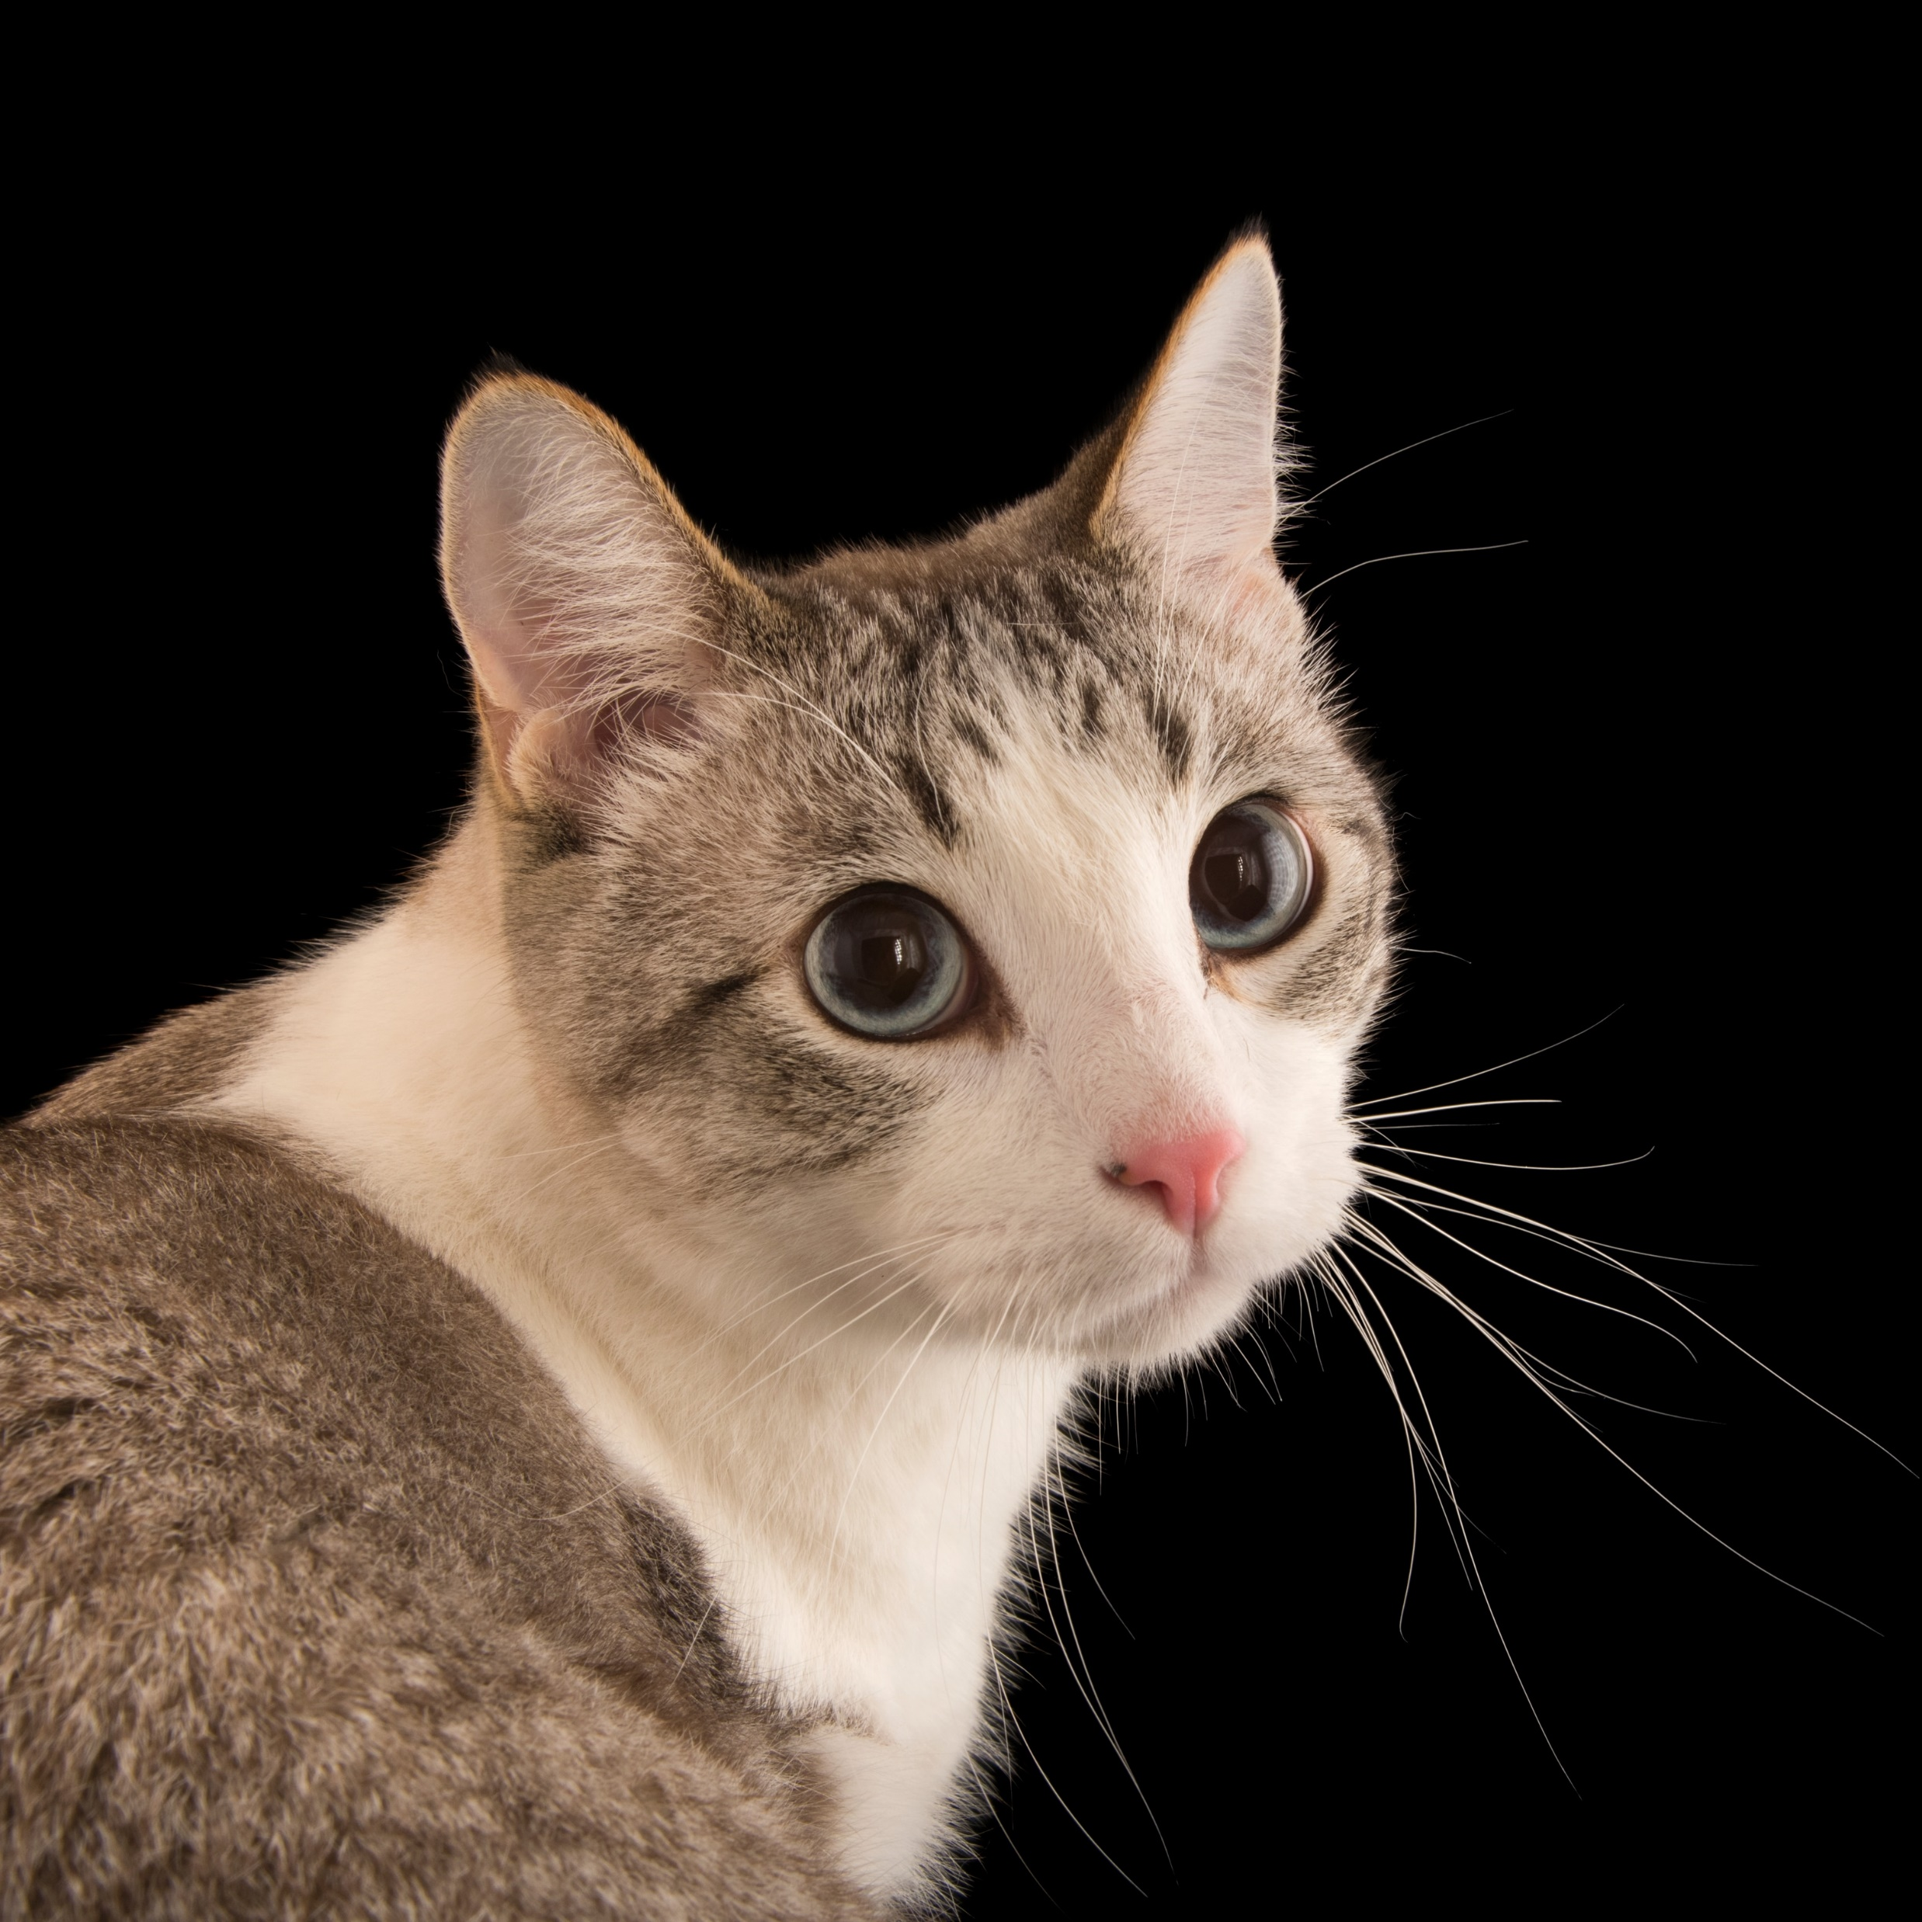
Convolutional Neural Network (CNN)
0.2
0.8
https://medium.com/swlh/building-a-simple-convolution-layer-from-scratch-317f82dc3805
Notes:
CNNs enforce a local connectivity pattern between neurons of adjacent layers.

Slide 26

Hands-on exercise 4:
Build convolution neural network and train it on mnist dataset (loading dataset using keras.datasets.mnist.load_data())
Details:
Two contolution layers, one with 32 filter, kernel size 3x3, another one with 64 filter, kernel size 3x3
One maxpolling layer

Slide 27

Coffee break

Slide 28
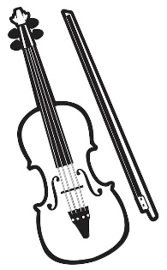





What is transfer learning and why?
Everyone does transfer learning since very little
Notes:
When we humans learn we don’t exactly start from scratch ,we might (intentionally or unintentionally) have some knowledge of the thing we are trying to learn , so we use our previous experience while learning something new or trying to complete a new task . Now how is it related to ML ?

Slide 29
What is transfer learning and why?
Transfer learning, used in machine learning, is the reuse of a pre-trained model on a new problem. In transfer learning, a machine exploits the knowledge gained from a previous task to improve generalization about another. For example, in training a classifier to predict whether an image contains food, you could use the knowledge it gained during training to recognize drinks.
Advantages:
1) save training time
2) not data hungry and you do not need a lot of data
3) neural network works better in most cases
https://medium.com/analytics-vidhya/transfer-learning-is-it-important-to-know-934eeb3c0ea
Image source: Pan & Yang, IEEE Trans Knowledge & Data Engineering 2009
Notes:
ML models do something similar which uses its previous experience from some other task to complete the current task it is termed as Transfer Learning.
The general idea is to use the knowledge a model has learned from a task with a lot of available labeled training data in a new task that doesn’t have much data. Instead of starting the learning process from scratch, we start with patterns learned from solving a related task.
The main advantages are basically that you save training time. Save training time is reduced because it can sometimes take days or even weeks to train a deep neural network from scratch on a complex task.
and that your neural network works better in most cases and you do not need a lot of data. You can build a solid machine learning model with relatively small training data because the model is already pre-trained.
It could also work with tasks such as Object detection or Face-Recognition ,let’s say in a task such as Face-Recog if you use a pre-trained model it can already detect the face and then it will be easy for to compare faces encodings to recognize them

Slide 30
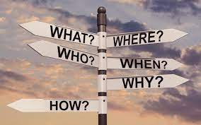
Transfer learning examples
Image classification
DTL: Disease-specific variants detections (Leah’s research project)

Slide 31


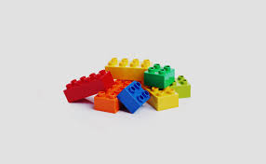
Image classification
Modern transfer learning:
Convolutional neural network,
Using a pre-trained model to solve a new similar problem
CAT
DOG
Images
Conv
Pooling
BN
Flatten
Dense
FNN
CAR
BIRD
Conv
Pooling
BN
FNN
Image sources: https://www.educba.com/tensorflow-image-classification/

Slide 32
Image classification
Tips for a successful transfer learning
Choose an appropriate pre-trained model
Type of the application (image-based, text-based, …)
Scale of the pre-trained model
Compatibility at both the input and output ends of the base model
Shape
Data type
Where to get pre-trained models?
Pre-trained models from other’s (https://github.com/)
Tensorflow Hub (previously Model Zoo) pre-trained models, (https://tfhub.dev/)
Notes:
GitHub is a web-based interface that uses Git, the open source version control software that lets multiple people make separate changes to web pages at the same time.
TensorFlow Hub is a repository of trained machine learning models ready for fine-tuning and deployable anywhere.

Slide 33
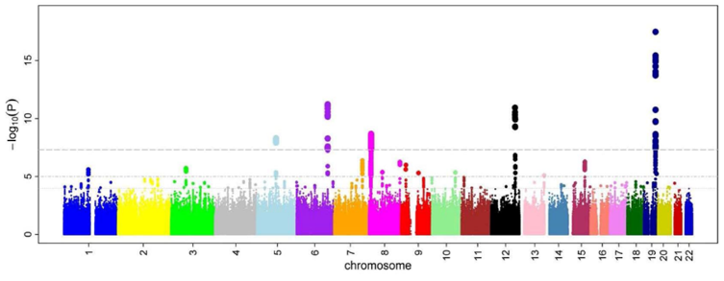
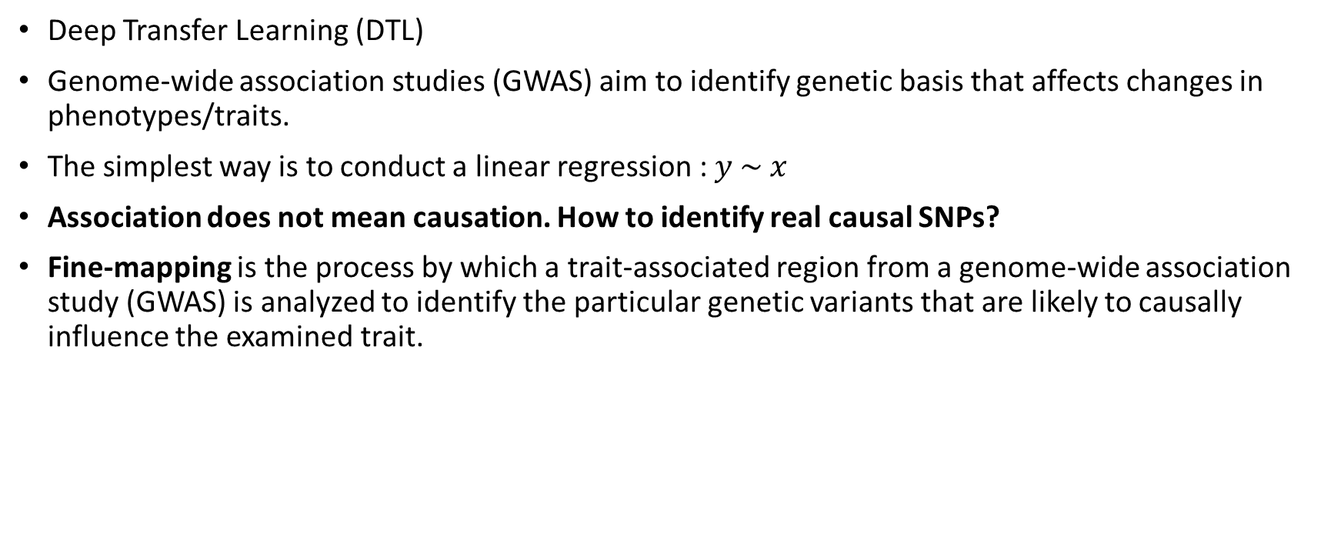
DTL: Disease-specific variants detections
Deep Transfer Learning (DTL)
Genome-wide association studies (GWAS) aim to identify genetic basis that affects changes in phenotypes/traits.
The simplest way is to conduct a linear regression : $y \sim x$
Association does not mean causation. How to identify real causal SNPs?
Fine-mapping is the process by which a trait-associated region from a genome-wide association study (GWAS) is analyzed to identify the particular genetic variants that are likely to causally influence the examined trait.
Notes:
Stringent

Slide 34
DTL: Disease-specific variants detections
Limitation of SuSiE: it gives the same prior probability to all SNPs
Nonsynonymous mutations >> synonymous
Coding region mutations > noncoding regions mutations
Polyfun: weight SNPs by their functional biological annotations
Input: hundreds/thousands of functional biological annotations
Output: per-SNP heritability, which can be regarded as the prior causal probability
Coding
Intron
Conserved
Coding
Intron
Conserved
-log10(p)
-log10(p)

Slide 35
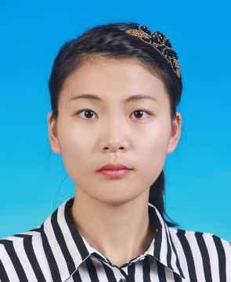
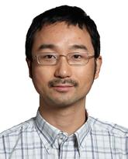
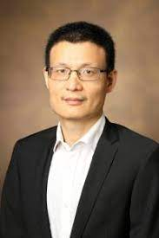
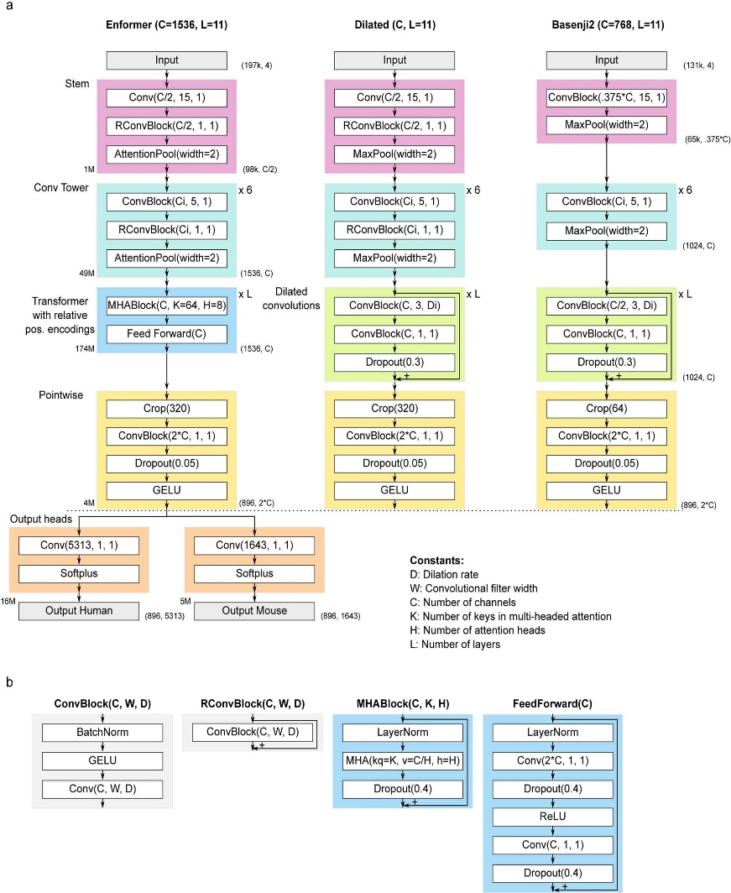


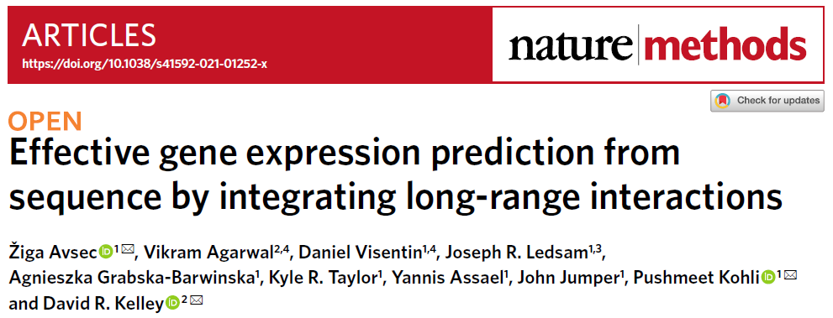
DTL: Disease-specific variants detections
Qing (Leah) Li
Quan Long
Xingyi Guo
Enformer
DTL
Standing on the shoulders of giants
Wow, giants!
Conv(275,1,1)
Softplus
Output Human
Notes:
I borrowed … I cut out the mouse output head and only keep human output head as my research study focus on detecting causal human genetic variants. I also adapted the shape for outputs to fit my target epigenetic data.

Slide 36
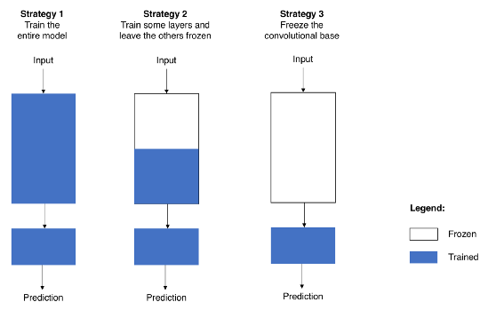
Repurposing a pre-trained model
Strategy 1: Train the entire model. Use the structure of the model that has already been learned and train it based on your information. need a big set of facts and a lot of processing power.
Strategy 2: Train some layers and leave the others frozen. Lower layers talk about general features that don't depend on the problem, while higher layers talk about specific features that do depend on the problem. If you have a small sample and a lot of factors, you'll leave more layers frozen to avoid overfitting. If the dataset is big and the number of parameters is small, you can improve your model by training more layers to the new job, since overfitting won't be a problem.
Strategy 3: Freeze the convolutional base. This is an extreme example of the trade-off between train and freeze. The basic idea is to keep the convolutional base in its original form and use its results to feed the classifier. You are using the pre-trained model as a fixed feature extraction method, which can be helpful if you don't have a lot of computing power, your dataset is small, or the pre-trained model solves a problem that is very close to the one you want to solve.
Source: https://medium.com/towards-data-science/transfer-learning-from-pre-trained-models-f2393f124751
Notes:
trategy 1 and Strategy 2 require you to be careful with the learning rate used in the convolutional part. The learning rate is a hyper-parameter that controls how much you adjust the weights of your network. When you’re using a pre-trained model based on CNN, it’s smart to use a small learning rate because high learning rates increase the risk of losing previous knowledge. Assuming that the pre-trained model has been well trained, which is a fair assumption, keeping a small learning rate will ensure that you don’t distort the CNN weights too soon and too much.

Slide 37
Data Augmentation
Popular Augmentation Techniques
Flip, Rotation, Scale,
Crop: randomly sample a section from the original image. We then resize this section to the original image size
Translation: moving the image along the X or Y direction (or both).
Gaussian Noise: random black and white pixels spread through the image
Notes:
When you don't have a large image dataset, it's a good practice to artificially introduce sample diversity by applying random, yet realistic, transformations to the training images, such as rotation and horizontal flipping. This helps expose the model to different aspects of the training data and reduce overfitting. You can learn more about data augmentation in this tutorial.

Slide 38
Hands-on exercise 5: Transfer learning
Task: Transfer pre-trained model MobileNet V2 on the classification of images of dogs and cats.
1. Load and examine pre-trained MobileNetV2
2. Add additional layers to form a new model
3. Load and examine datasets
4. Train the new model
5. Fine-tune the new model
https://colab.research.google.com/drive/1p7lmhIh1AUKJx-aZnbdsBoqmpS3p0DrS

Slide 39
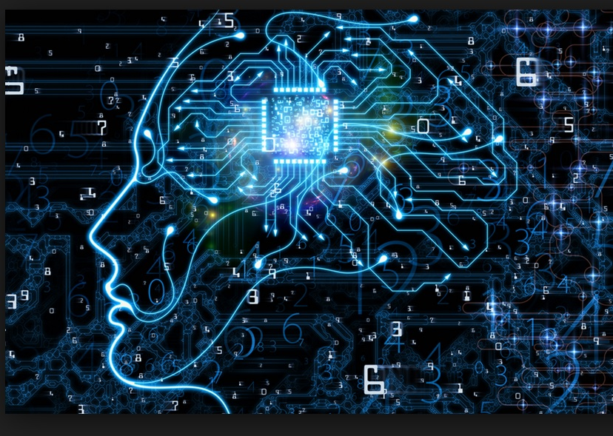
Thank you
Questions OR Comments?
Slack channel: section2-course-documents
Email: qing.li2@uclagary.ca
This Photo by Unknown Author is licensed under CC BY-SA-NC

